Slide 1


Frequency-tuned ACM for Biomedical Image Segmentation
Qing Guo, Shuifa Sun, Fanmin Dong, Wei Feng, Bruce Zhi Gao and Siyu Ma
tsingqguo@tju.edu.cn, watersun1977@hotmail.com

Slide 2
Outline
Classical Region based ACMs
Frequency Boundary Energy
Frequency Filter Designing
Relationship with Classical RACMs
DoG filter
Experimental Results
Conclusion

Slide 3
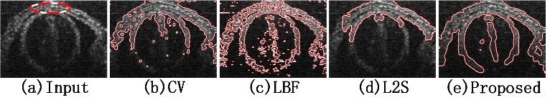
Classical Region based ACMs
Problem
Biomedical images are usually corrupted by strong noise and intensity inhomogeneity simultaneously, which challenges classical RACMs, e.g. CV model, LBF model, LIF model etc.
T. F. Chan and L. A. Vese, “Active contours without edges,”IEEE TIP, vol. 10, no. 2, pp. 266–277, 2001.
K. Zhang, H. Song, and L. Zhang, “Active contours driven by local image fitting energy,”PR, vol. 43, no.4, pp.1199–1206, 2010 .
C. Li, C.-Y. Kao, J. C. Gore, and Z. Ding, “Minimization of region-scalable fitting energy for image segmentation,” IEEE TIP, vol. 17, no. 10, pp. 1940–1949, 2008.
S. Mukherjee and S.-T. Acton, “Region based segmentation in presence of intensity inhomogeneity using legendre polynomials,” IEEE SPL, vol. 22, no. 3, pp. 298–302,2015.
Notes:
Active contour models (ACMs) can obtain sub-pixel precision segmentation and smooth contours, and are widely employed in medical image segmentation. In particular, region-based Active Contour Models can handle various noise and weak edges usually found in medical images. However, biomedical images are usually corrupted by strong noise and intensity inhomogeneity simultaneously, which challenges classical region-based Active Contour Models, such as CV model, LBF model, LIF model and recently proposed L2S model. The figure shows that classical models fail to segment an optical coherence tomography image being corrupted by strong noise and intensity inhomogeneity simultaneously.

Slide 4
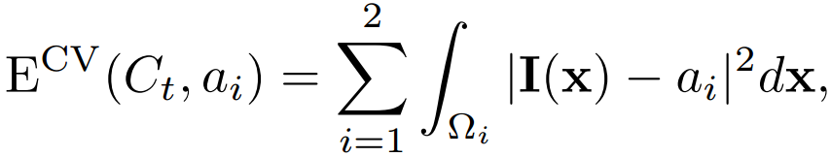
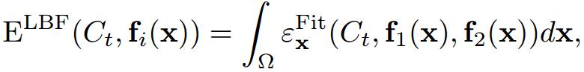
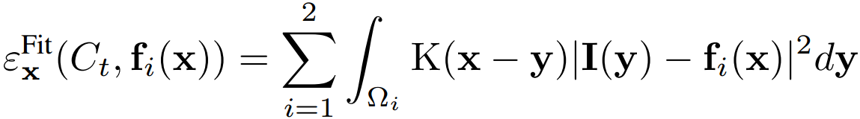
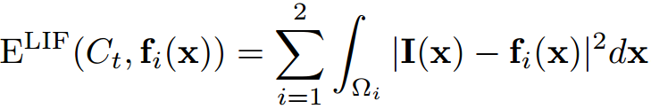
Classical Region based ACMs
Chan-Vese (CV) model
CV can segment homogeneous images effectively. However, it fails to handle intensity inhomogeneity.
With local region information, LBF and LIF can segment images with intensity inhomogeneity. However, they are sensitive to strong noise
Classical RACMs fail to segment images with strong noise and intensity inhomogeneity simultaneously.
Local Binary Fitting (LBF) model
Local Image Fitting (LIF) model
Notes:
The slide shows the energy functions of three classical region based Active Contour Models. Such models aim to drive an initial contour C_{t} to the object boundary by minimizing the corresponding energy function. The contour C_{t} divides the image region into two sub-regions Ω₁ and Ω_{2.} The energy functions are defined according to different region information in the two sub-regions. For example, in CV model, a_{i} is the average intensity of the sub-region Ω_{i} and regarded as the global region information; in LBF and LIF model, f_{i}(x) is the local weighted average in sub-region Ω_{i}. According to experimental results, we get following conclusions: CV model can segment homogeneous images effectively. However, it fails to handle intensity inhomogeneity; with local region information, LBF and LIF can segment images with intensity inhomogeneity. However, they are sensitive to strong noise. Thus, classical region based Active Contour Models fail to segment images with strong noise and intensity inhomogeneity simultaneously.

Slide 5
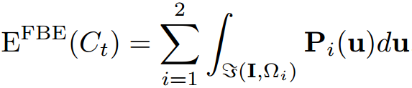
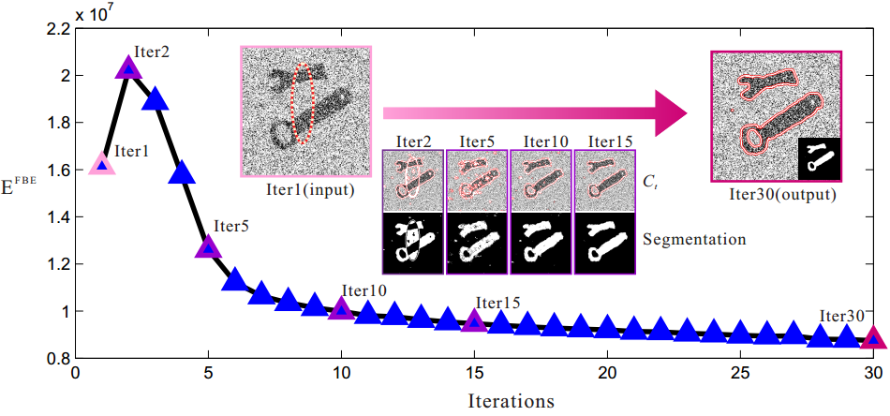
Frequency Boundary Energy
The energy of C contained in Ω/C_{t} is presented as
Notes:
Here, I will introduce the proposed frequency boundary energy. As shown in the right figure, C is the boundary between the object and the background., i.t. the white line. C_{t} is the contour at step t. Ω₁ is the region inside the contour C_{t} ; . Ω₂ is the sub-region outside C_{t.} The Active Contour Model aims to restrain C_{t} to C and gets segmentation with the information from the two sub-regions.
In frequency domain, we focus on the energy of the object boundary C in sub-regions (Ω₁ and Ω₂) and define P_{i} as the power spectra of C in Ω_{i}. u is the coordinate vector in frequency domain .We hold that when the energy of C in both sub-regions vanishes, that is, C is not included in any sub-regions, Ct equals to C with segmentation being obtained. Thus, we define this energy as the Frequency Boundary Energy (FBE). We show an example in the figure, with the frequency boundary energy vanishes in the sub-regions, the C_{t} gradually fits the object boundary.

Slide 6
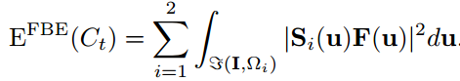
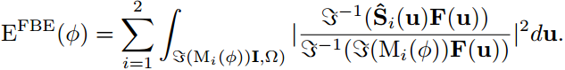
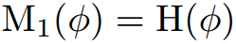
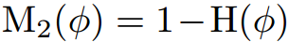
Frequency Boundary Energy
With a frequency filter F(u), FBE is rewritten as
By representing C_{t} as the level set function Φ and getting the sub-region via Heaviside function H(), we have
Thus, Selection of F(u) is the key to achieve effective segmentations.
Notes:
In frequency domain, we can use a frequency filter (F(u)) to extract the C for sub-region Ω_{i} and rewrite frequency boundary energy. S_{i} is the fourier transform of sub-region Ω_{i}. By representing Ct as the level set function Φ and using the Heaviside function H(Φ), we get the frequency boundary energy with respect to level set function. According to this definition, Selection of F(u) is the key to achieve effective segmentations.

Slide 7
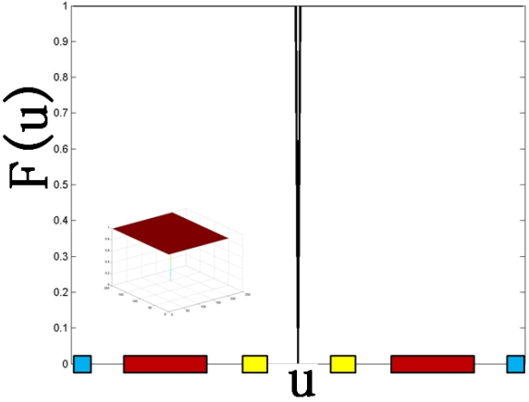
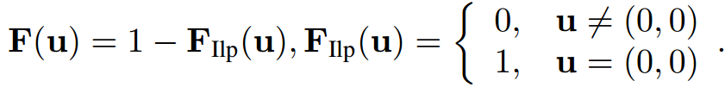
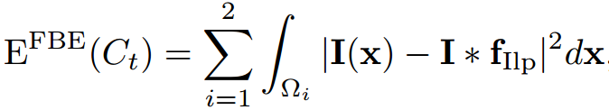
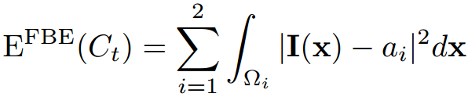
Frequency Filter Designing
F(u) as an ideal high-pass filter
Due to energy conservation of fourier transform, FBE can be rewritten in spatial domain
Convoluting the Ω_{i} with ideal low-pass filter equals to calculate the average value of Ω_{i} , we have
Thus, CV is a specific form of FBE model when F(u) is set as an ideal high-pass filter, which makes FBE contain both boundary and other interference, e.g. strong noise and intensity inhomogeneity, which leads the CV model is easily affected by noise and intensity inhomogeneity.
Notes:
Here, we introduce the frequency filter designing and show that the proposed model is a generalized region based active contour model. We first set frequency filter as an ideal high-pass filter and replace it into frequency boundary energy. Due to energy conservation of fourier transform, frequency boundary energy can be rewritten in spatial domain. f_{Ilp} is the spatial filter of F_{Ilp}; *( asterisk ) denotes the convolution operation. Since convoluting the Ω_{i} with ideal low-pass filter equals to calculate the average value of Ω_{i}, we can rewrite the frequency boundary energy that has the same formulation with CV model. Thus, CV model is a specific form of FBE model when F(u) is set as an ideal high-pass filter. At this point, the frequency boundary energy contains both boundary and other interference, e.g. strong noise and intensity inhomogeneity, which leads the CV model to be easily affected by noise and intensity inhomogeneity.

Slide 8
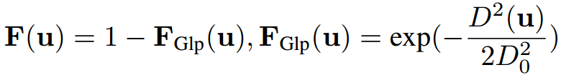
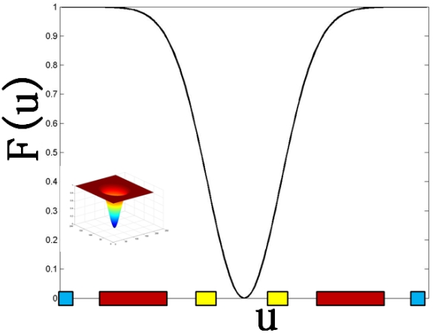
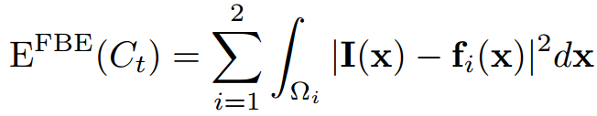
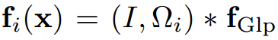
Frequency Filter Designing
F(u) as a Gaussian high-pass filter
In spatial domain, FBE can be rewritten as
Thus, LIF is a specific form of FBE model when F(u) is set as a Gaussian high-pass filter helping to limit the intensity inhomogeneity which is a low frequency component. However, the noise is still included in the FBE which makes LIF fail to handle images with strong noise.
Notes:
Similarly, when we set frequency boundary filter as a Gaussian high-pass filter, the frequency boundary energy becomes the LIF model. Thus, as shown in the figure, the Gaussian high-pass filter helps to limit the intensity inhomogeneity which is a low frequency component. However, the noise is still included in the FBE which makes LIF fail to handle images with strong noise.

Slide 9
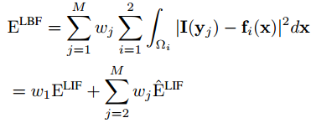
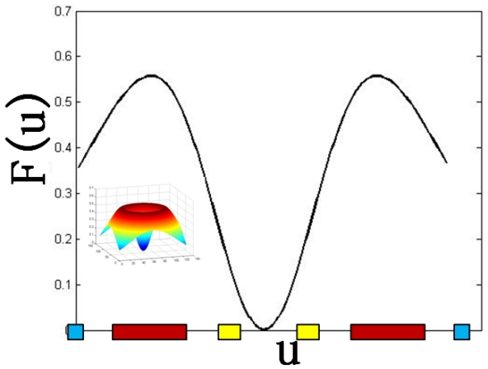
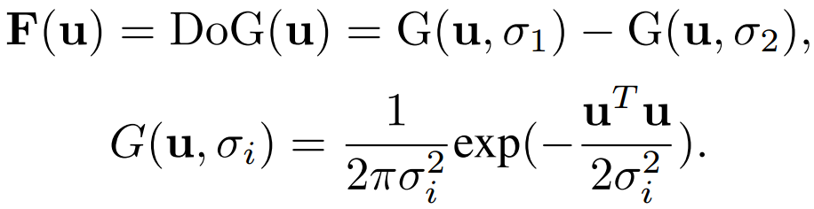
Frequency Filter Designing
Furthermore, LBF can be represented by LIF
This explains why LIF can obtain results similar to those of LBF.
F(u) as a DoG filter
The bandwidth and position of the DoG filter are determined by the values and ratio of σ₁ and σ₂. Therefore, by selecting the correct σ_{i} for different images, FBE-DoG can obtain the better segmentation result.
Notes:
Furthermore, we can represent the LBF energy as the weighted combination of LIF energy and its approximation. This explains why LIF model can obtain results similar to those of LBF model. We have shown that the classical region based Active Contour Models are the special cases of proposed FBE model by setting ideal or Gaussian high-pass filter as the F(u) and cannot handle strong noise and intensity inhomogeneity simultaneously. To get better segmentation, we propose to set F(u) being a band-pass filter to limit both high and low frequency interferences. The bandwidth and position of the DoG filter are determined by the values and ratio of σ₁ and σ_{2.} Therefore, by selecting the correct σ_{i} for different images, our method can obtain the good segmentation result.

Slide 10
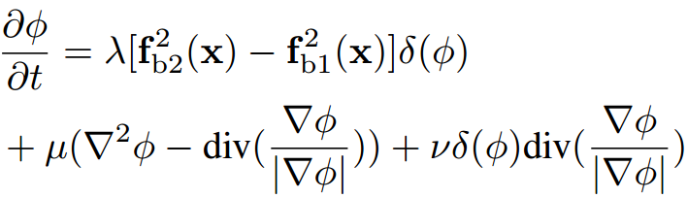
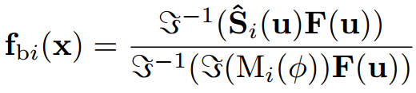
Frequency Filter Designing
Optimization
Combining with the length and level set regularization term , we get the evaluation function of level set function with gradient decent algorithm
In summary, FBE model is a generalized RACM . The designing of F(u) is the key to get good segmentation results. To tackle strong noise and intensity inhomogeneity simultaneously, the F(u) should suppress both information. Thus, we propose the DoG based FBE model.
Notes:
With the DoG filter, we combine the energy function with the length and level set regularization term and get the evaluation function of level set function via gradient decent algorithm. In summary, FBE model is a generalized region based Active Contour Model. The designing of F(u) is the key to get good segmentation results. To tackle strong noise and intensity inhomogeneity simultaneously, the F(u) should suppress both information. Thus, we propose the DoG based FBE model.

Slide 11
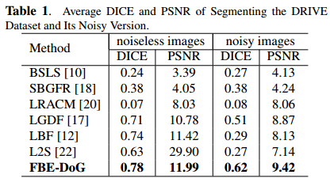
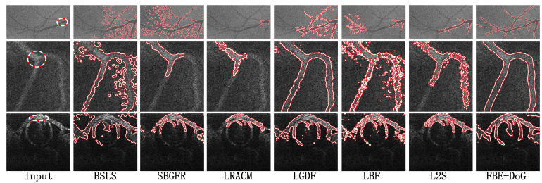
Experimental results
Comparing with state-of-the-art methods
Dataset: DRIVE dataset containing 40 noiseless retinal images to evaluate the performance of our method. We add Gaussian noise to this dataset and get a noisy version.
Metrics: DICE and PSNR
J. Staal, M.D. Abramoff, M. Niemeijer, M.A. Viergever, and B. van Ginneken, “Ridge-based vessel segmentation in color images of the retina,” IEEE Trans. Med. Imag., vol. 23, no. 4, pp. 501–509, 2004.
Notes:
We use the DRIVE dataset to evaluate our method. DRIVE dataset contains 40 noiseless retinal images which are seriously corrupted by intensity inhomogeneity. Furthermore, we extend a noise version by add serious additive Gaussian noise to DRIVE dataset to evaluate the ability of handling strong noise and intensity inhomogeneity simultaneously. The classical metrics, i.e. DICE and PSNR, are used to evaluate the performance. We compare our method with six state-of-the-art methods. As shown in Table 1, our method outperforms all previous methods. As shown in the figure, our method achieves the best segmentation accuracy with smooth contour.

Slide 12
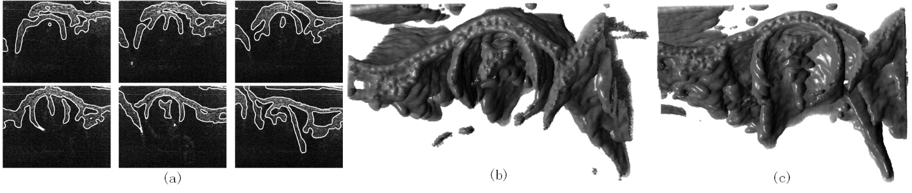
Experimental results
Application to segment OCT image sequence
R. Wang, J.-X. Yun, R. Goodwin, R. Markwald, T.-K. Borg,R.-B. Runyan, and B. Gao, “4d imaging of embryonic chick hearts by streak-mode fourier domain optical coherence tomography,” Proc. SPIE, vol. 8207, pp. 82073V–82073V–6, 2012.
Notes:
With DoG based frequency boundary energy, we segment an OCT image sequence obtained from an embryonic chick heart tube to reconstruct a 3D model. These OCT images are corrupted by both strong noise and intensity inhomogeneity. The initial contour is selected manually to segment the first image of the sequence. Thereafter, the result of segmentation of the previous image is used as the initial contour for the next image. A 3D model is made based on the segmentation results, as shown in the figure. This application shows that the FBE-DoG model overcomes the influence of noise and intensity inhomogeneity in medical images and extracts the main information, for example the heart tube.

Slide 13
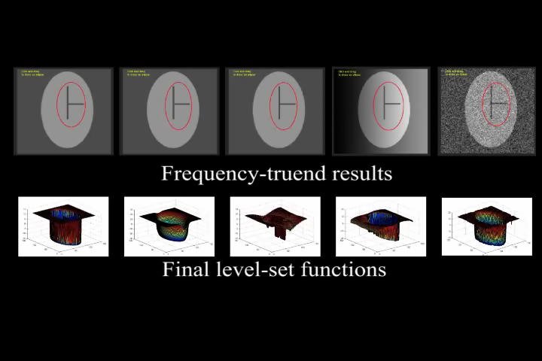
Experimental results
Discussion-selective segmentation
Notes:
By setting different bandwidth and position for DoG filter, we show that DoG based FBE model is able to realize selective segmentation, that is, to segment different part in the same image. (这里需要点击播放)

Slide 14
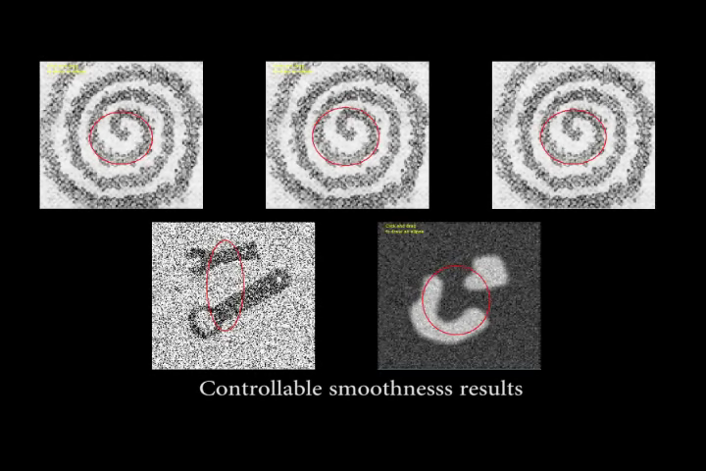
Experimental results
Discussion-Controllable smoothness
Notes:
We also show that our method is able to control the smoothness of contour by setting the degree to suppress high frequency information. (这里需要点击播放)

Slide 15
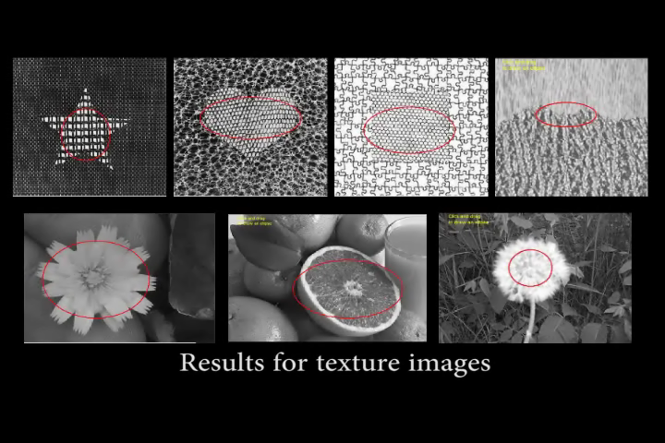
Experimental results
Discussion-Segmenting texture images without texture feature
Notes:
We also perform an interesting experiment. With DoG filter, we can segment texture images without extracting texture feature and realize good result on some natural images. (这里需要点击播放)

Slide 16
Conclusion
We have proposed a generalized region-based ACM in frequency domain by defining a frequency boundary energy (FBE). We use DoG filter to extract the FBE, which can segment images with strong noise and intensity inhomogeneity.
Notes:
We have proposed a generalized region-based ACM in frequency domain by defining a frequency boundary energy (FBE). We use DoG filter to extract the FBE, which can segment images with strong noise and intensity inhomogeneity. The comparison results and OCT image segmentation demonstrate the excellent performance of our method.

Slide 17
Thank you!
tsingqguo@tju.edu.cn
Notes:
Thank you! If you have any questions, please contact the author with the email address!

